Slide 1
Lab Molecular Dynamics
2024-10-31
Andrew Grieder
Yuan ping
Credits to Ben Afflerbach Dane Morgan

Slide 2
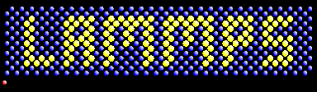
Large-scale Atomic/Molecular Massively Parallel Simulator (LAMMPS)

Slide 3
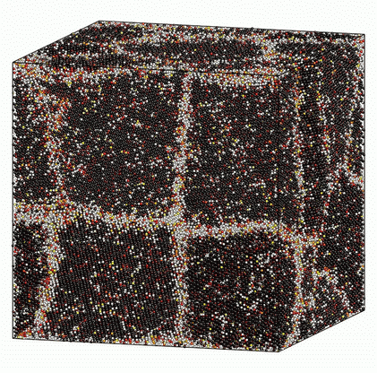
LAMMPS is…
Open Source
Distributed by the United States Department of Energy (DOE)
Comes with potentials for solid-state materials, soft matter, and mesoscopic systems
Flexible enough to be used at atomic, meso, or continuum scale

Slide 4
Inputs and outputs
Potential file (fixed and usually obtained from an outside source)
Describes how atoms interact
Can determine which physics can be captured by the simulation
Script file (flexible and customized to specific runs)
Sets up initial atom positions and momentums
Sets running conditions like time step and run time
Can perform post-processing for calculating non-trivial properties at each time step

Slide 5
Inputs and outputs
Log File
Gives information like overall runtime of a simulation, computational performance, and thermodynamic information at specific time steps
Will also give errors if the run fails for any reason
Customized output files
Trajectory files
Thermo files

Slide 6
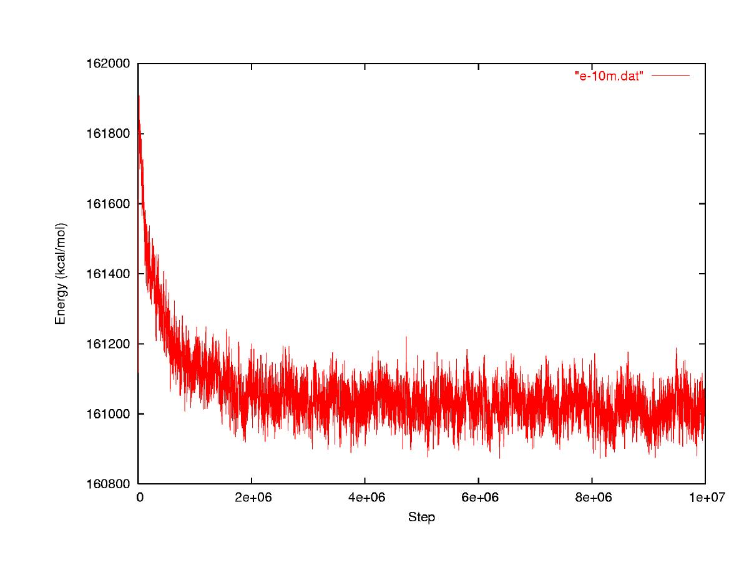
Equilibration Periods
Equilibration period: Not equilibrated, thermal averages may be wrong
Converged: Equilibrated, thermal averages will be right
Energy
√<(δE)²>
<E>+/-σ_{<E>}
MC Step
http://mccammon.ucsd.edu/~dzhang/research/ccmv/
Can be done automatically but generally done by eye.

Slide 7
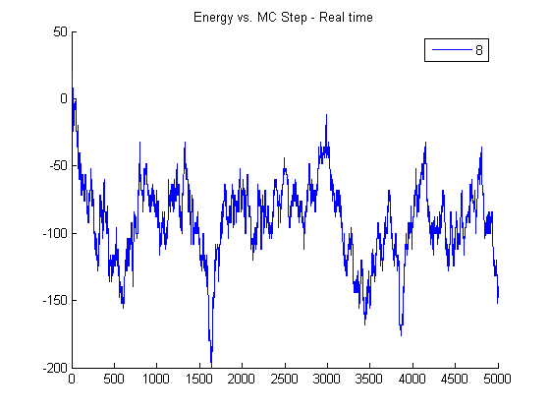
Block (Bin) Averaging to Get Error in <E>
Equilibration period
Bin 1
Bin 2
Bin 3
Bin 4
Energy
<E>+/-σ_{<E>}
<E>_{bin}
MD Step
Must take bins > correlation length so they are independent samples.

Slide 8
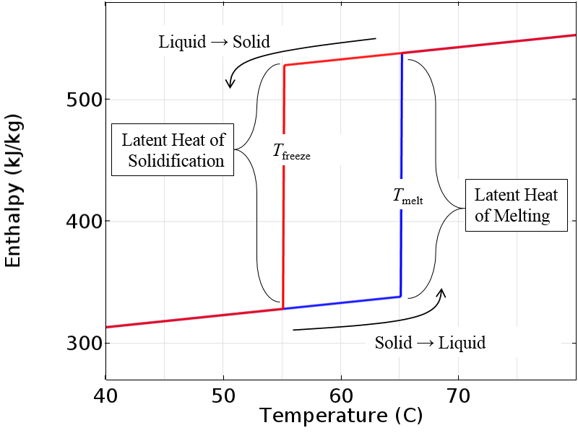
Important Features of Melting
https://www.comsol.com/blogs/thermal-modeling-of-phase-change-materials-with-hysteresis/

